Slide 1
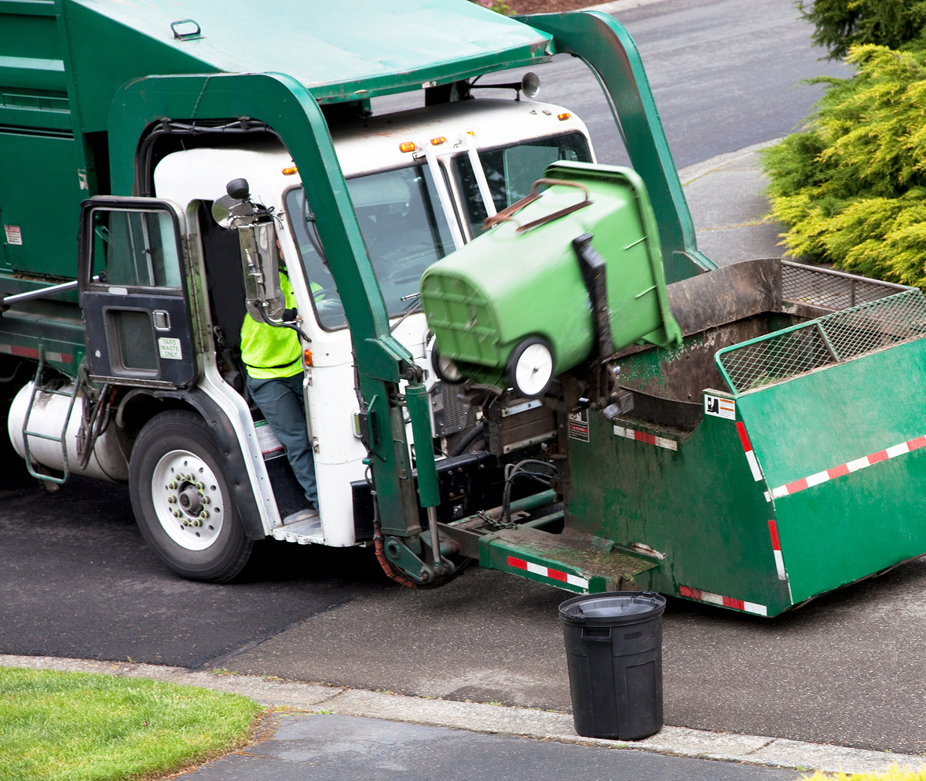


Waste Management
Business Plan

Slide 2

Table of Contents
I. Executive Summary | 3
II. The Organization | 4
III. Business Description | 6
IV. Services List | 7
V. Industry Background | 8
VI. Competitor Analysis | 9
VII. Market Analysis | 11
VIII. Marketing Plan | 12
IX. Operational Plan | 14
X. SWOT Analysis | 14

Slide 3

Executive
Summary
Give a brief explanation for the page
Mission and Vision
At [Add Your Company name], our mission is to provide efficient and sustainable
waste management solutions that promote a cleaner and healthier environment.
Our values include integrity, accountability, sustainability, and customer satisfaction.
The Services | [Add Your Company name] provides services such as waste collection, waste transportation, waste disposal, recycling, and composting.
The Leadership | Leslie Boatwright founded the company after years in the tech industry. She serves as Founder and CEO.
The Overall Industry | Five major players dominate the waste management industry in [Region]. However, [Add Your Company name] aims to offer consumers a greener alternative.
The Competitors | Major competitors include Competitor 1, Competitor 2, Competitor 3, and Competitor 4. [Add Your Company name] will differentiate its products from theirs by using recycled and renewable materials.
The Projected Finances | Revenue: $600,000 Cost of services: $250,000 Gross profit: $350,000 Operating and marketing expenses: $250,000 Net income: $100,000
Future Plans | By 2026, the company plans to implement its collection and recycling program in three cities.

Slide 4

The Organization
Give a brief explanation for the page
Add Name Here
Add Designation
She is responsible for the overall strategic direction and vision of the our business, ensuring that it stays competitive and profitable while upholding its values and mission.
Add Name Here
Add Designation
He oversees the financial operations of our business, managing budgets, forecasting financial performance, and ensuring compliance with regulatory requirements.
Add Name Here
Add Designation
She oversees the day-to-day operations of the our business, ensuring that services are delivered efficiently and effectively while maintaining high standards of quality and safety.

Slide 5


The Organization
Give a brief explanation for the page
Hierarchy of the Organization
LEADERSHIP
Operations Manager
Sales & Marketing Manager
Waste collectors
Business development executive
Waste collectors
Business development executive

Slide 6
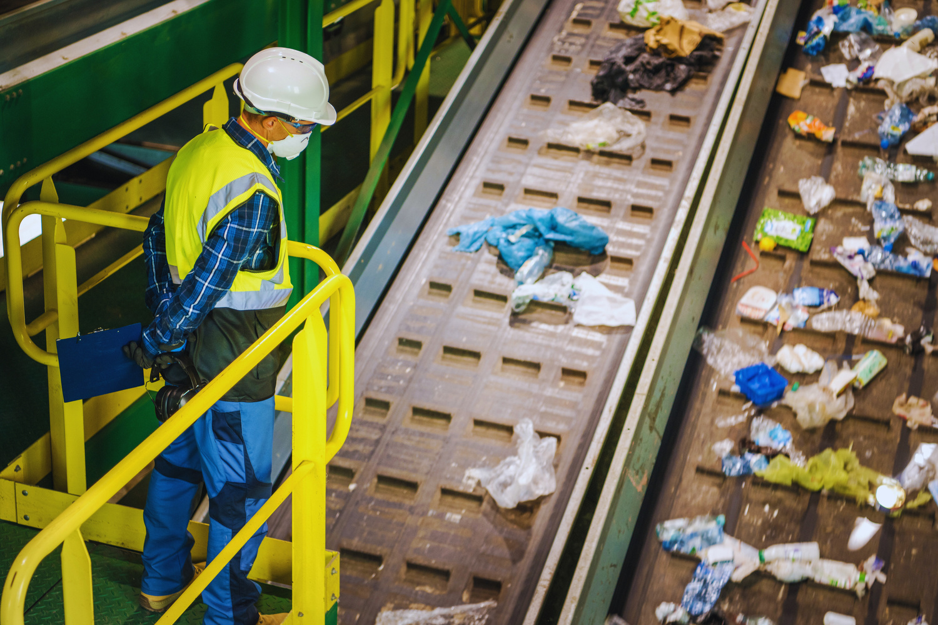
Business Description
Give a brief explanation for the page
Waste Management Solutions
Our waste management company, [Add Your Company name], aims to provide efficient and eco-friendly waste management solutions to businesses and households in the local area.
Our services include waste collection, transportation, and disposal, as well as recycling and composting services. We are committed to providing affordable and sustainable waste management solutions while minimizing our environmental impact.

Slide 7




Services List
Give a brief explanation for the page
Waste collection
We provide curbside collection of household and commercial waste using specialized trucks.
Waste transportation
We transport waste to our designated landfill sites using our own fleet of vehicles.
Waste disposal
We dispose of waste in an environmentally friendly manner, adhering to all regulations and guidelines.
Recycling
We provide recycling services for paper, plastic, glass, and metal products, diverting waste from landfills.

Slide 8
Industry Background
Give a brief explanation for the page
Waste Management Market
Waste management is a growing industry that focuses on the collection, transportation, and disposal of waste products. With increasing urbanization and population growth, the amount of waste generated worldwide is expected to increase significantly over the next few decades.
The global waste management market is projected to reach $484.9 billion by 2025, growing at a CAGR of 5.1% from 2020 to 2025. This growth is driven by increasing environmental concerns, stringent regulations, and the adoption of sustainable waste management practices.
Lack of reliable brands
Even though four major players dominate this market, [Add your Company Name] aims to provide business owners with an alternative that is more reliable and affordable.
Competitor 1
Competitor 2
Competitor 3
Competitor 4
0
20
40
60

Slide 9
Competitor Analysis
Give a brief explanation for the page
Competitor 1
Strengths | Weaknesses | Opportunitis | Threats
Affordable Strong customer base Readily available for services | Does not meet quality standards Adds to e-waste in landfills | Expansion into neighboring areas Growing demand Increased spending on technology | Increasing number of competition Shift towards sustainability Economic downturns
Competitor 2
Strengths | Weaknesses | Opportunitis | Threats
Affordable Strong customer base Readily available for services | Does not meet quality standards Adds to e-waste in landfills | Expansion into neighboring areas Growing demand Increased spending on technology | Increasing number of competition Shift towards sustainability Economic downturns

Slide 10
Competitor Analysis
Continued
Competitor 3
Strengths | Weaknesses | Opportunitis | Threats
Affordable Strong customer base Readily available for services | Does not meet quality standards Adds to e-waste in landfills | Expansion into neighboring areas Growing demand Increased spending on technology | Increasing number of competition Shift towards sustainability Economic downturns
Competitor 4
Strengths | Weaknesses | Opportunitis | Threats
Affordable Strong customer base Readily available for services | Does not meet quality standards Adds to e-waste in landfills | Expansion into neighboring areas Growing demand Increased spending on technology | Increasing number of competition Shift towards sustainability Economic downturns

Slide 11

Market Analysis
Give a brief explanation for the page
Know Your Target Audience
01
Geographic Segment
  In which region do they live?
  Are they rural, urban, or suburban?
02
Demographic Segment
  What is their age, gender, and race?
  How much do they earn?
  What do they do?
  What are their educational qualifications?
03
Psychographic Segment
  What are their pain points?
  What are their budget?
  What are their attitudes?
  What social and cultural norms do they follow?
04
Behavior Segment
  What are their hobbies and habits?
  Are they tech-savvy?
  Which social media do they use?
  What are their purchasing style?

Slide 12

Marketing Plan
Give a brief explanation for the page
Touching More Lives
Our marketing strategy includes:
1. Creating a website and social media presence to reach potential customers.
2. Offering promotions and discounts to incentivize customers to try our services.
3. Networking with local businesses and organizations to build relationships and increase visibility.
4. Implementing a referral program to encourage customers to refer us to their friends and family.

Slide 13

Operational Plan
Give a brief explanation for the page
Hiring and training a team of waste management professionals with experience and expertise in the field.
Acquiring a fleet of specialized waste collection and transportation vehicles.
Our
Operational
Plan
Partnering with local landfill sites and recycling facilities to ensure safe and efficient waste disposal.
Implementing an efficient and eco-friendly waste management system that minimizes our environmental impact.
Expenses | Value | Percentage
Marketing and Advertising | $125,000 | 25%
Cost of Services | $250,000 | 50%
Daily Operations | $125,000 | 25%
TOTAL EXPENSES | $500,000 | 100%

Slide 14
SWOT Assesment
Give a brief explanation for the page
Strengths: | Weaknesses:
Experienced and knowledgeable team. Eco-friendly and sustainable waste management practices. Affordable and competitive pricing. | Lack of brand recognition and reputation. Limited resources and capacity for growth. Dependence on local landfill sites for waste disposal.
Opportunities: | Threats:
Growing demand for eco-friendly waste management solutions. Expansion into neighboring areas and markets. Diversification into other waste management services. | Competition from established players in the market. Stringent regulations and compliance requirements. Economic downturns and market fluctuations.

Slide 15
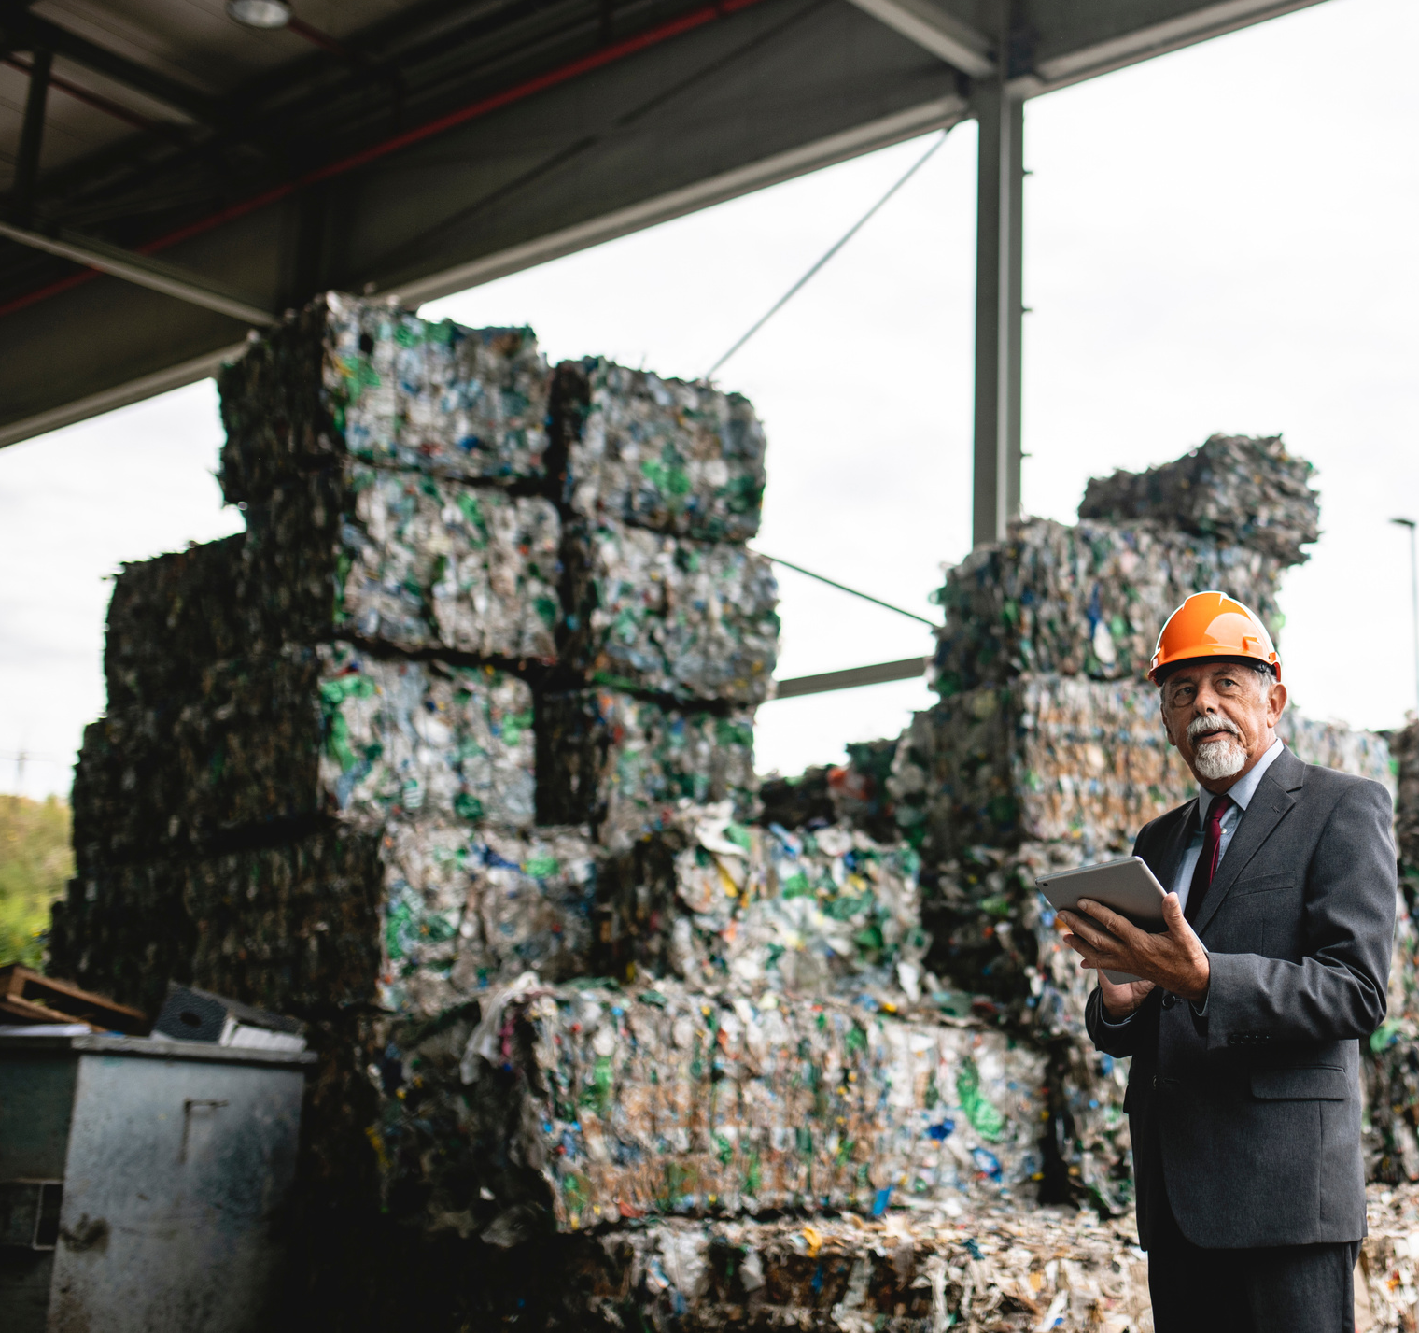




Contact us
for further inquiries
+1 (000) 111-2222
www.companywebsite.com
contact@companywebsite.com
Your company's address

